Slide 1
We’re ready to welcome you back with a roar!

Slide 2
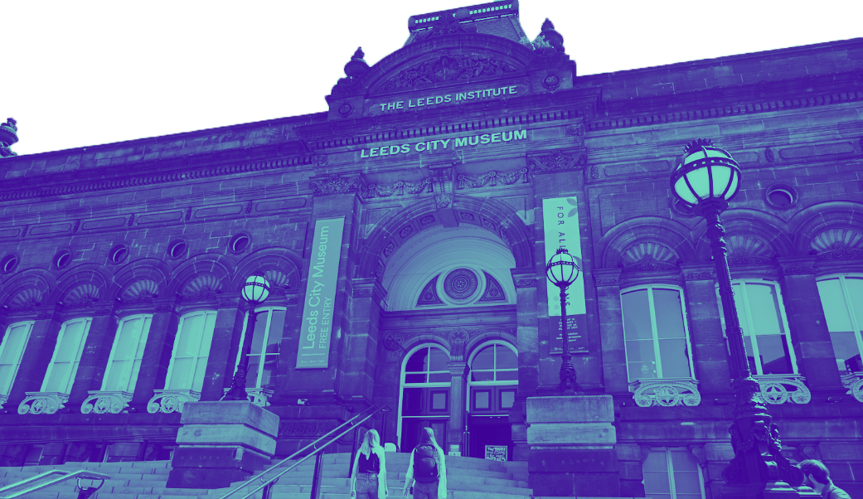
We’ve made some changes to protect you

Slide 3
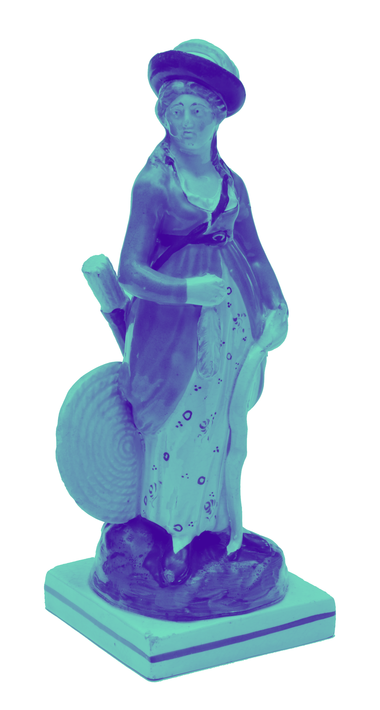
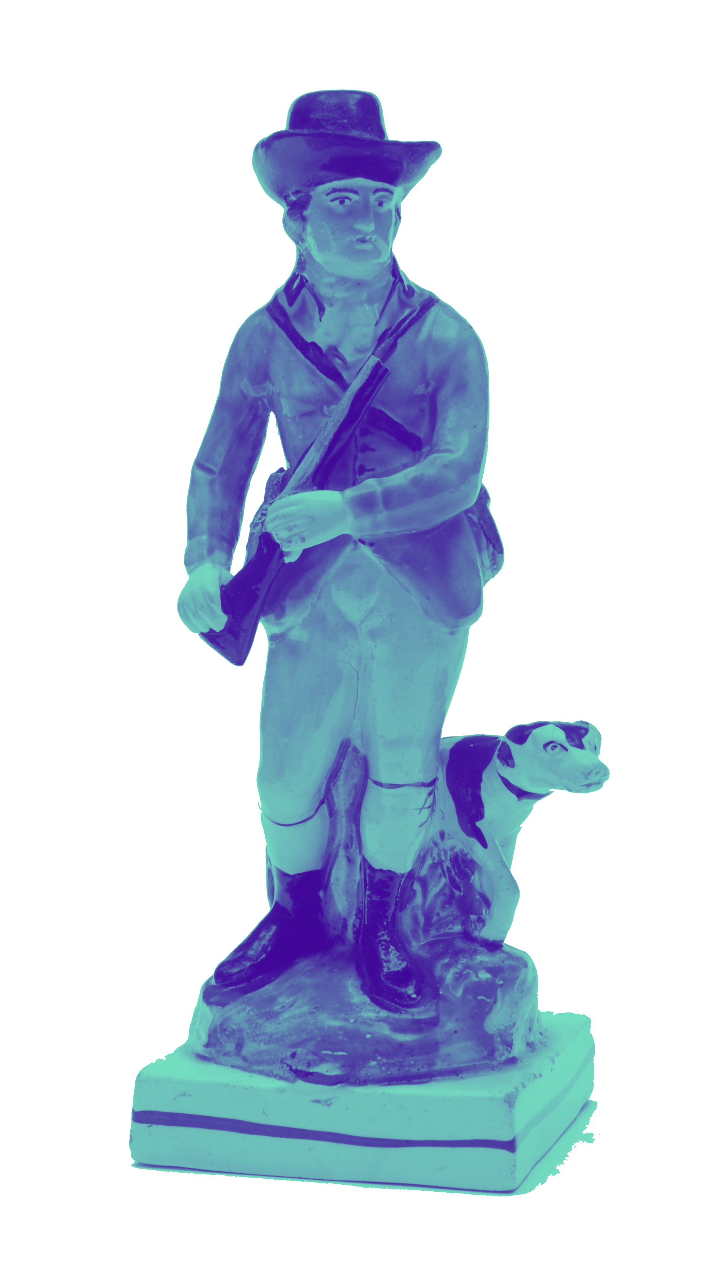
You may have to queue as we are limiting numbers

Slide 4
Please put on your face covering before visiting

Slide 5
A Red Kite’s wingspan is up to 179cm!
Please maintain
social distancing

Slide 6
Our team is here to help.
Please follow our visitor routes.

Slide 7
Please use hand sanitizer. We’ll be doing regular cleaning checks.

Slide 8
We accept cash but prefer contactless in our café and shop

Slide 9
Free entry
See you soon!
citymuseum.leeds.gov.uk

